Slide 1

Insurance Premium Prediction and Analysis
Team Member : Anushiya, Deva Kumaran V , Dharam Chand R , Magesh S, Nitish S

Slide 2
Objective:
Predictive Analytics for Insurance Premiums
Cost Reduction Strategies
Claims Risk Assessment
Business Use Case:
Premium Personalization
Customer Retention Strategies
Healthcare Cost Management

Slide 3
Data Description
Age: Age of the individual.
Sex: Gender of the individual (male/female).
BMI: Body Mass Index.
Children: Number of children/dependents.
Smoker: Whether the individual smokes (yes/no).
Claim_Amount: The amount claimed by the individual.
Past_consultations: Number of past medical consultations.
Num_of_steps: Number of steps taken (possibly daily or monthly; dataset doesn't specify).
Hospital_expenditure: Expenditure incurred on hospital-related services.

Slide 4
Contd..
Number_of_past_hospitalizations: Count of previous hospitalizations.
Annual_Salary: Annual income of the individual.
Region: The region the individual belongs to.
Insurance premium charges: The premium amount charged for the individual's insurance(Target)
BMI category:BMI category of the people.

Slide 5


Methodology
Data Preprocessing:
Remove Duplicate Rows.
Check for Anomalies.
Handle missing values.
Feature Engineering.
Standardize columns.
Assess distributions.
Statistical Analysis(5 Point Summary).

Slide 6
2. Exploratory Analysis:
Univariate
Bivariate
Multivariate

Slide 7
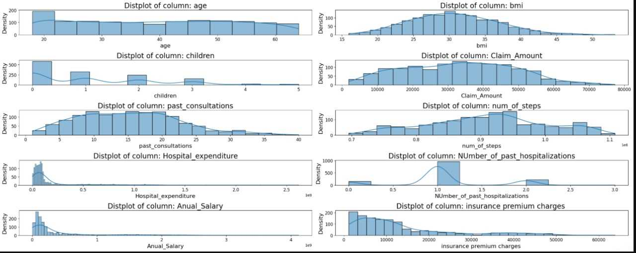
Univariate Analysis

Slide 8
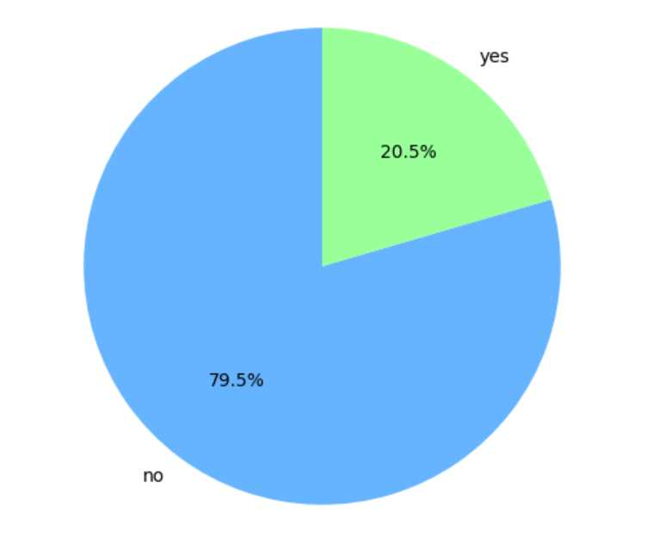
Count of Smokers

Slide 9
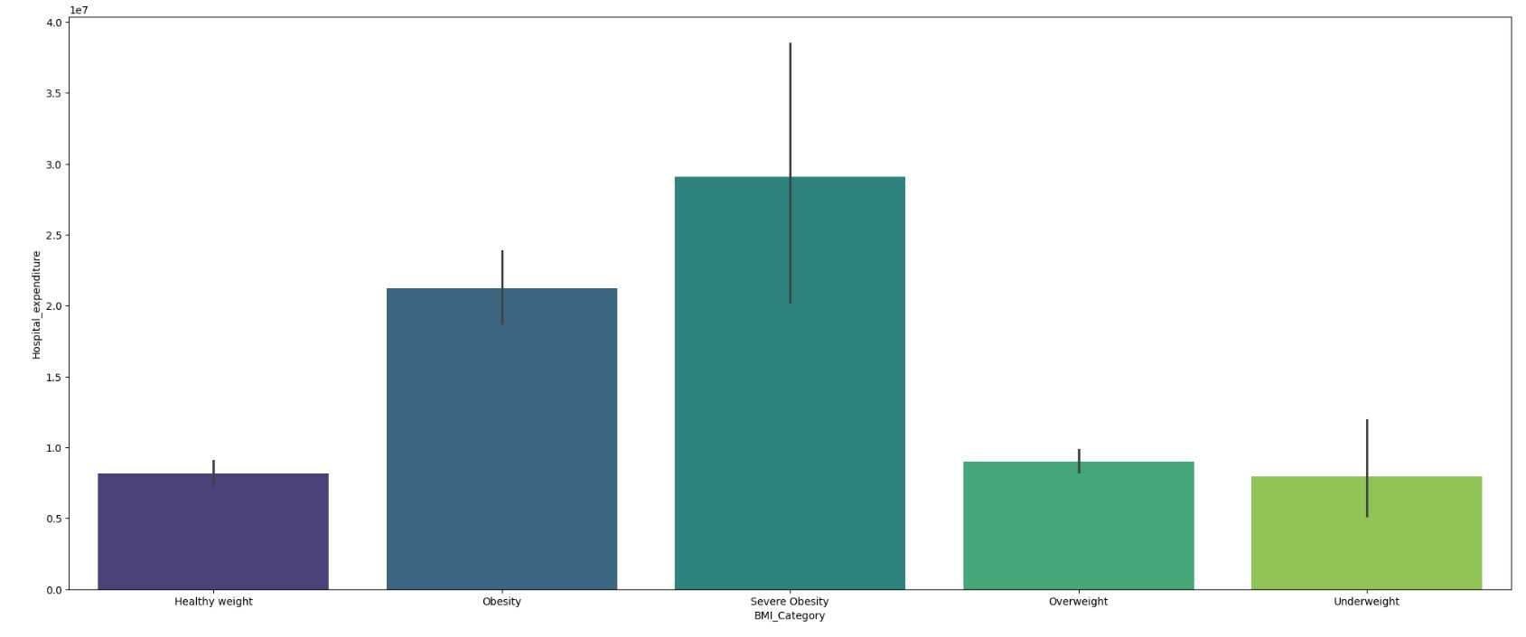
Bivariate Analysis
Hospital Expenditure vs BMI Category

Slide 10
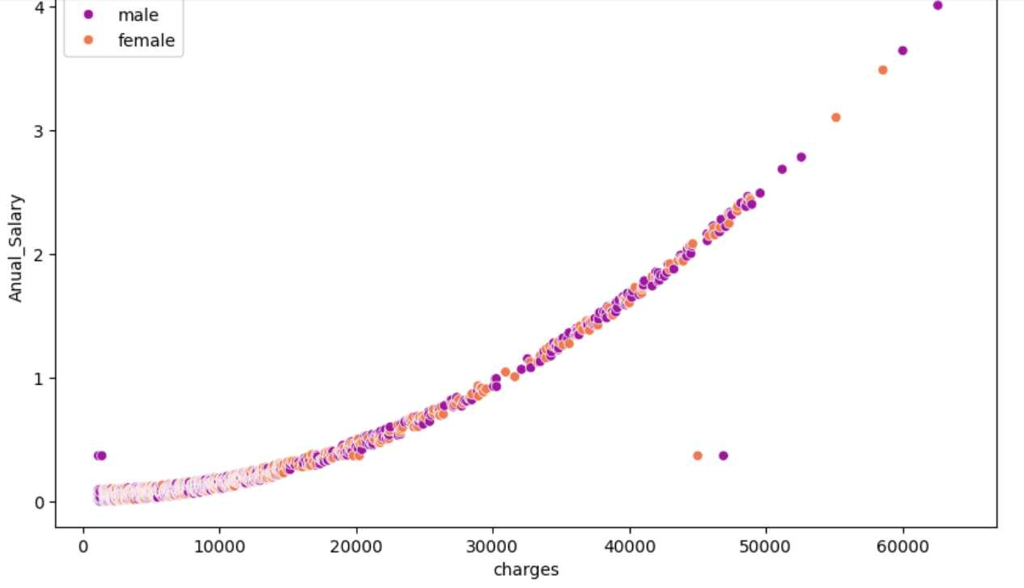
Multivariate Analysis
Annual salary vs premium charges vs Gender

Slide 11

Statistical Testing
Chi-Square Test
T-Test(Unpaired)
Anova Test

Slide 12
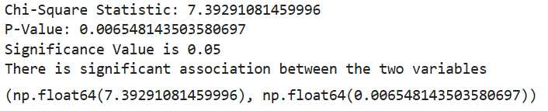
Chi-Square Test
Smoker vs Gender

Slide 13
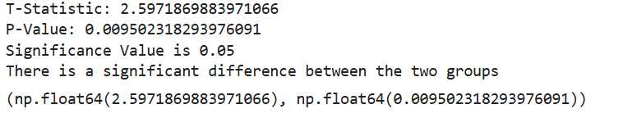
T-Test(Unpaired)
Smoker vs Hospital Expenditure

Slide 14
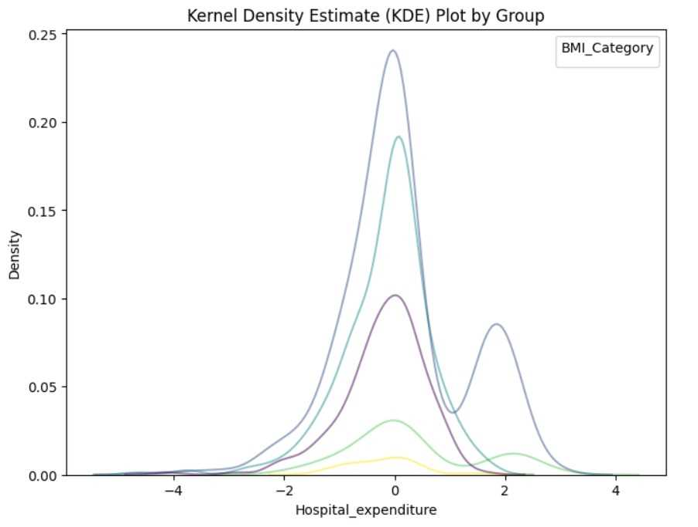
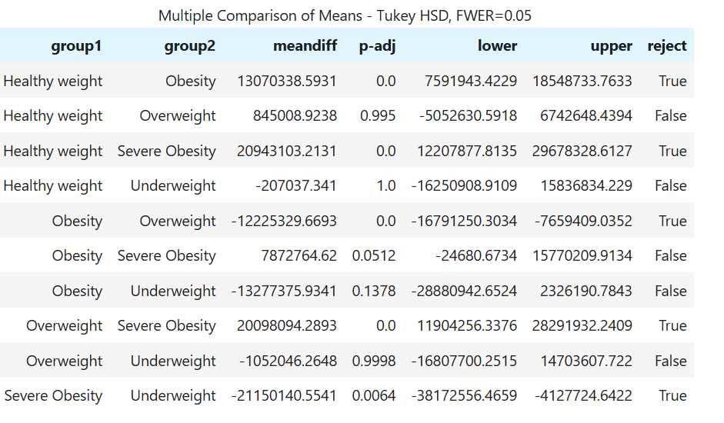
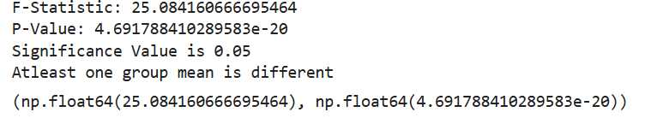
Anova Test
BMI Category vs Hospital Expenditure

Slide 15

Model Development
Linear Regression
Decision Tree
Ada Boost
Gradient Boost
XG boost

Slide 16
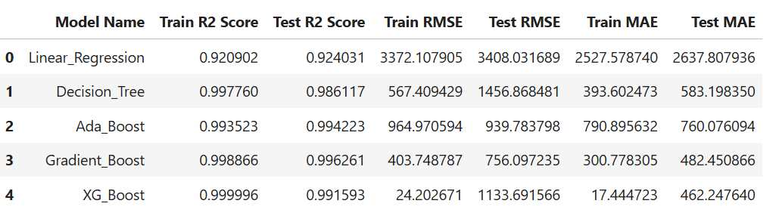
Model Evaluation
Best Model:
Gradient Boost

Slide 17

Business Recommendation
Customized Premium Strategies
Wellness & Preventive Health Plans
Target Marketing for Demographics
Employee Insurance Programs for High Earners
Addressing Medical Outliers
Expand in Underperforming Regions
Build Tech-Driven Claim Processes

Slide 18

Thank You

